Slide 1
API Services – Building apps that stand out
Personal | Useful | Fast | Engaging
Alan Ho

Slide 2
Agenda
Getting your app to stand out
How your backend gets in the way
Show you how Apigee solves your backend complexity

Slide 3
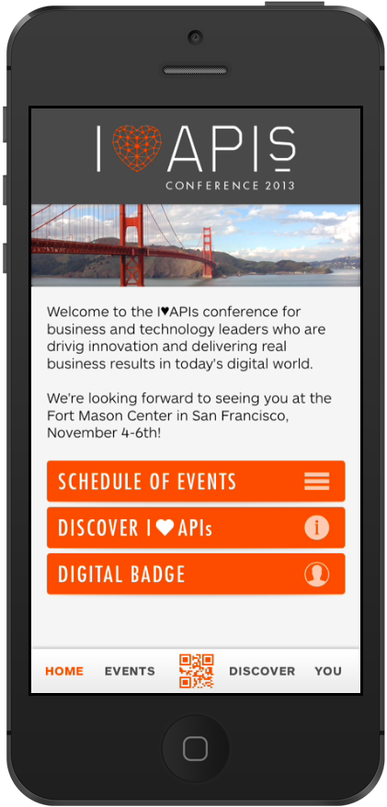
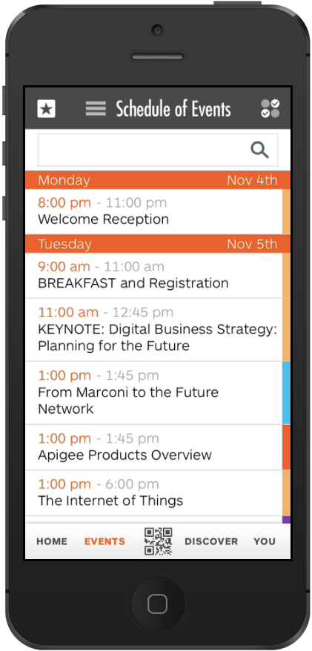
Getting your app to stand out
Personal
Useful
Fast
Engaging

Slide 4
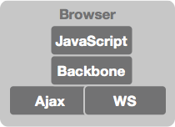
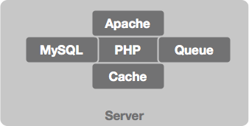
So you start building an app

Slide 5

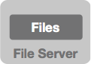
Adding pictures

Slide 6
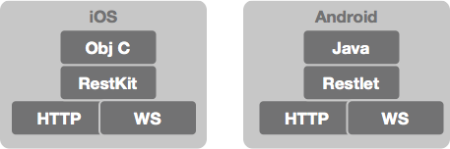
Going native

Slide 7
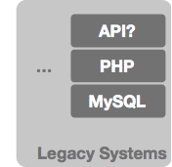
Integrating identity management

Slide 8
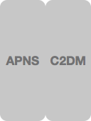
Increasing engagement

Slide 9

The app is the tip of the iceberg
Your App
App Servers
Legacy Systems
CDN
SQL DBs
NoSQL
APNS / GCM

Slide 10


Hiding the complexity with an API
Single API
Social
API Proxy
Location
Legacy Backend
Push
Transform
Datastore
Users Mgmt
3rd Party Backend

Slide 11
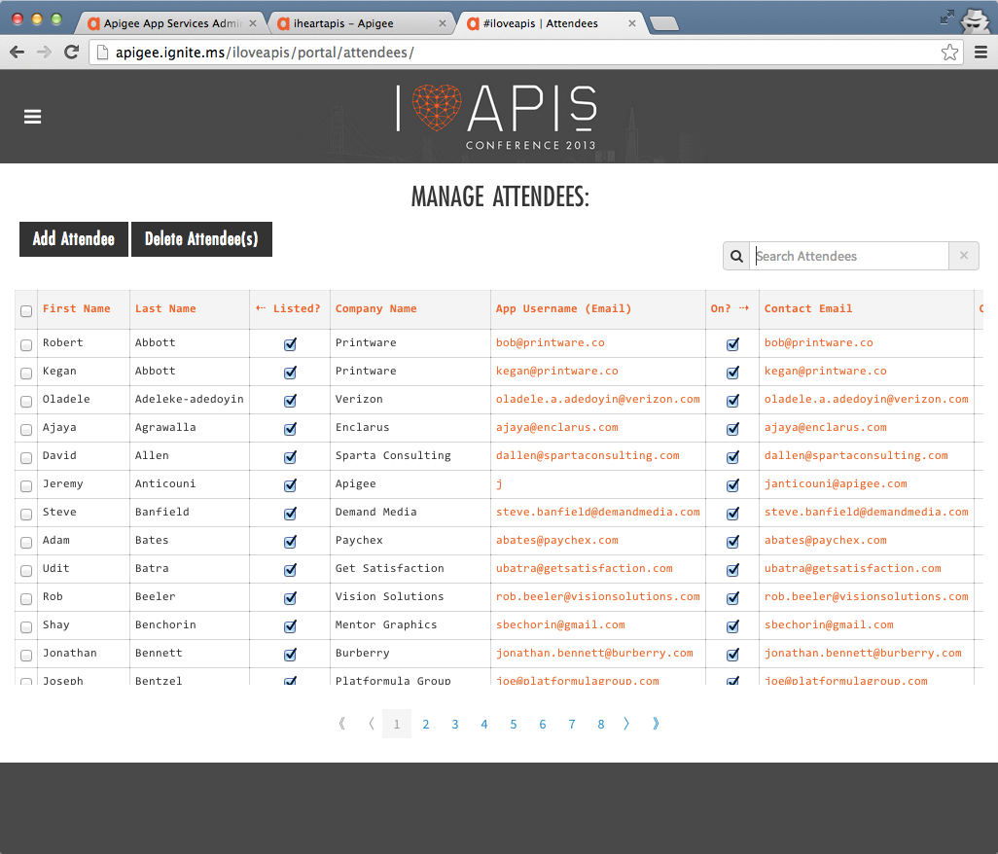
Employee and Conference apps
Single API
Social
API Proxy
Location
Legacy Backend
Push
Transform
Datastore
Users Mgmt.
3rd Party
Backend

Slide 12
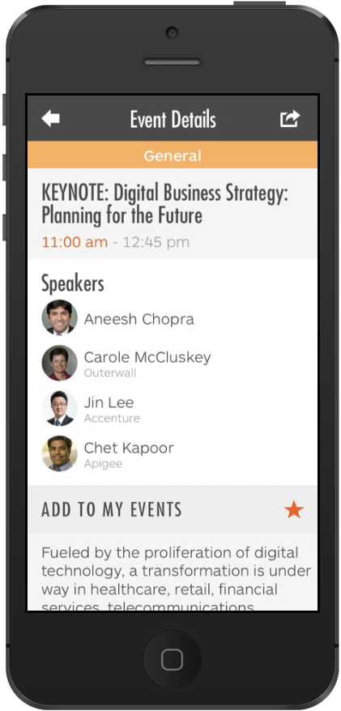
Session Details – Making it fast
Datastore
GET /sessions
GET /sessions/keynote/speaking

Slide 13
Session Details – Making it fast
Proxy
Datastore
GET /SessionMashup
GET /sessions
GET /session/<…>/speaking
Build aggregate
Populate Cache

Slide 14
Employee and Conference apps – Personal | Useful | Fast | Engaging
Single API
Social
API Proxy
Location
Legacy Backend
Push
Transform
Datastore
Users Mgmt.
3rd Party
Backend

Slide 15
Next Steps
Attend the Coder Workshop
Meet us at the Internet of Things Booth

Slide 17
Backup Slides (In case things don’t work)

Slide 18
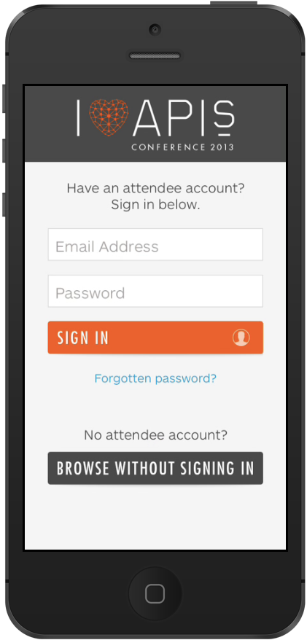
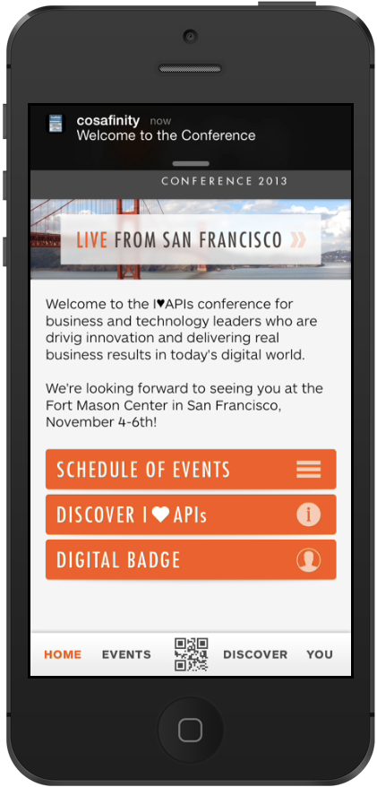
Short Demo
User Management
Data Backend
Proxy
Push

Slide 19
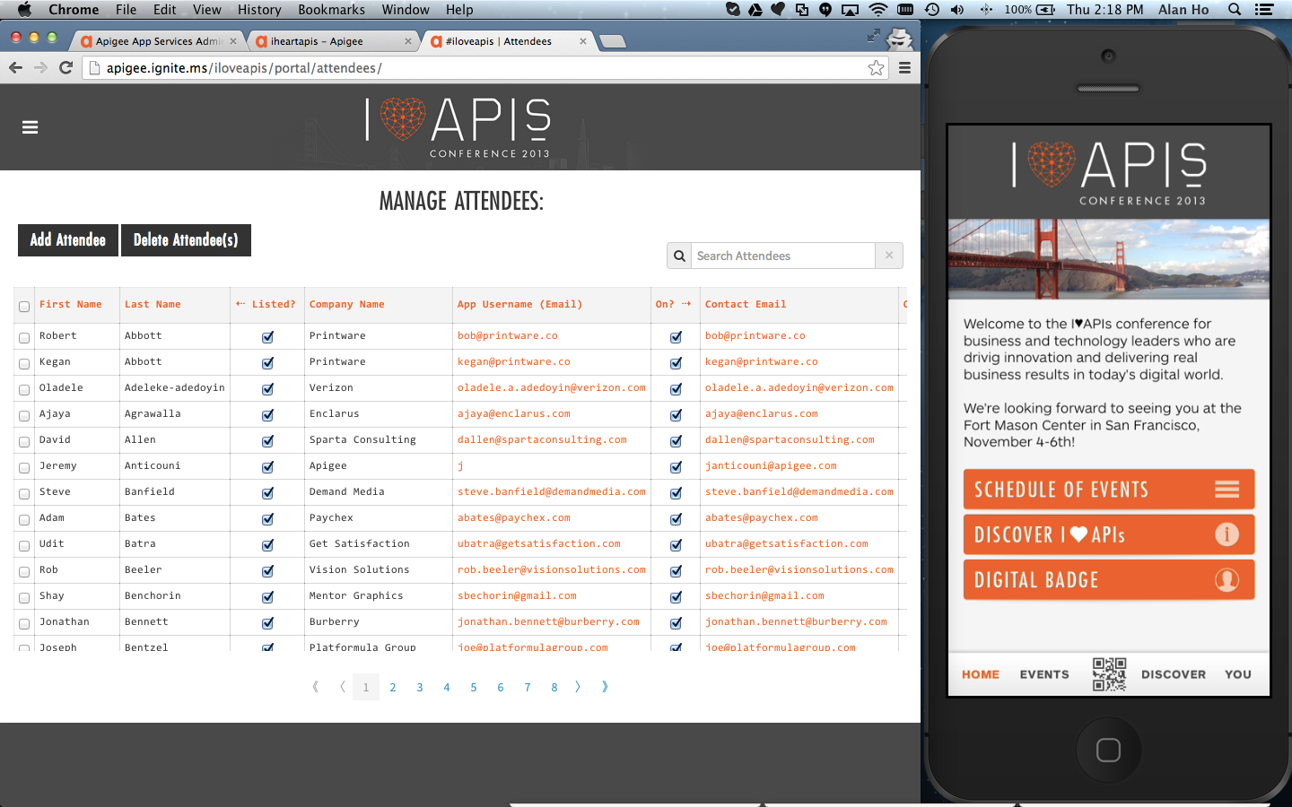
Conference App & Employee App

Slide 20
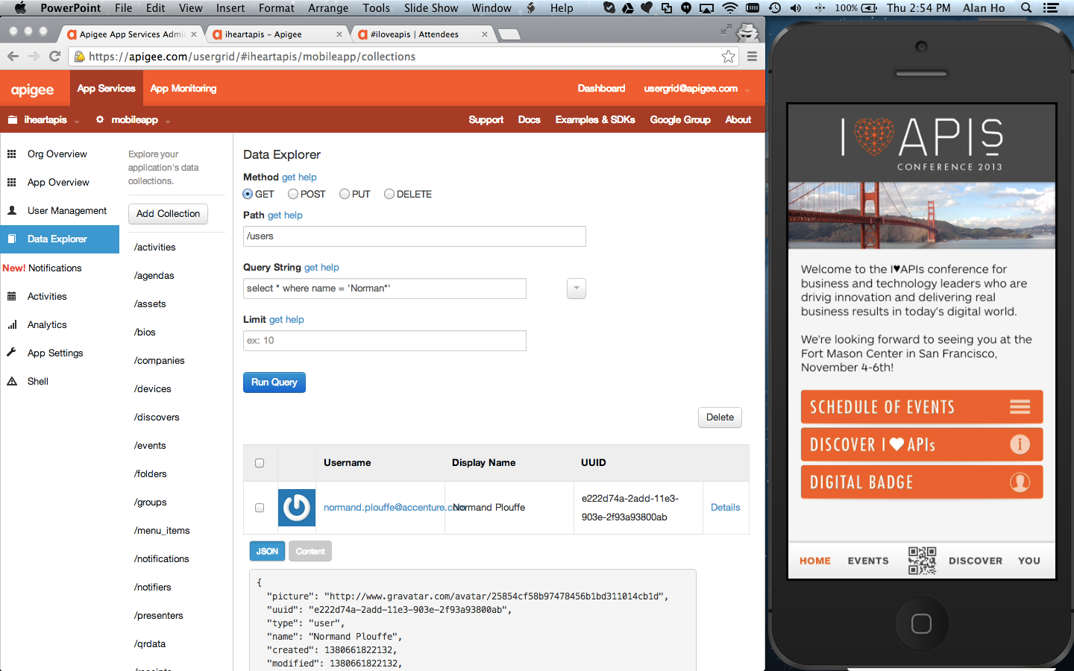
User Management

Slide 21
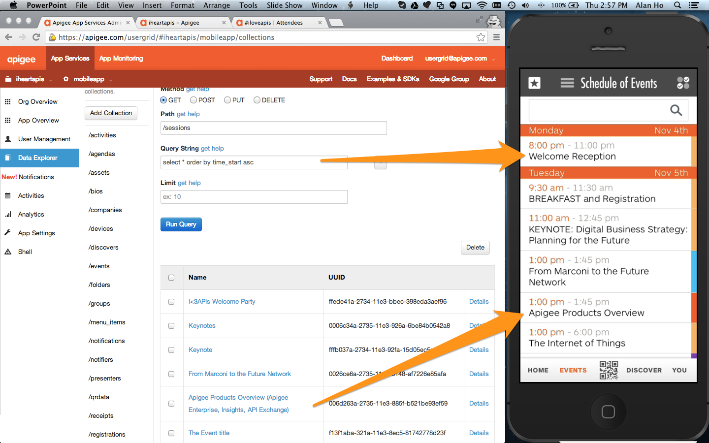
Datastore – Custom Collections

Slide 22
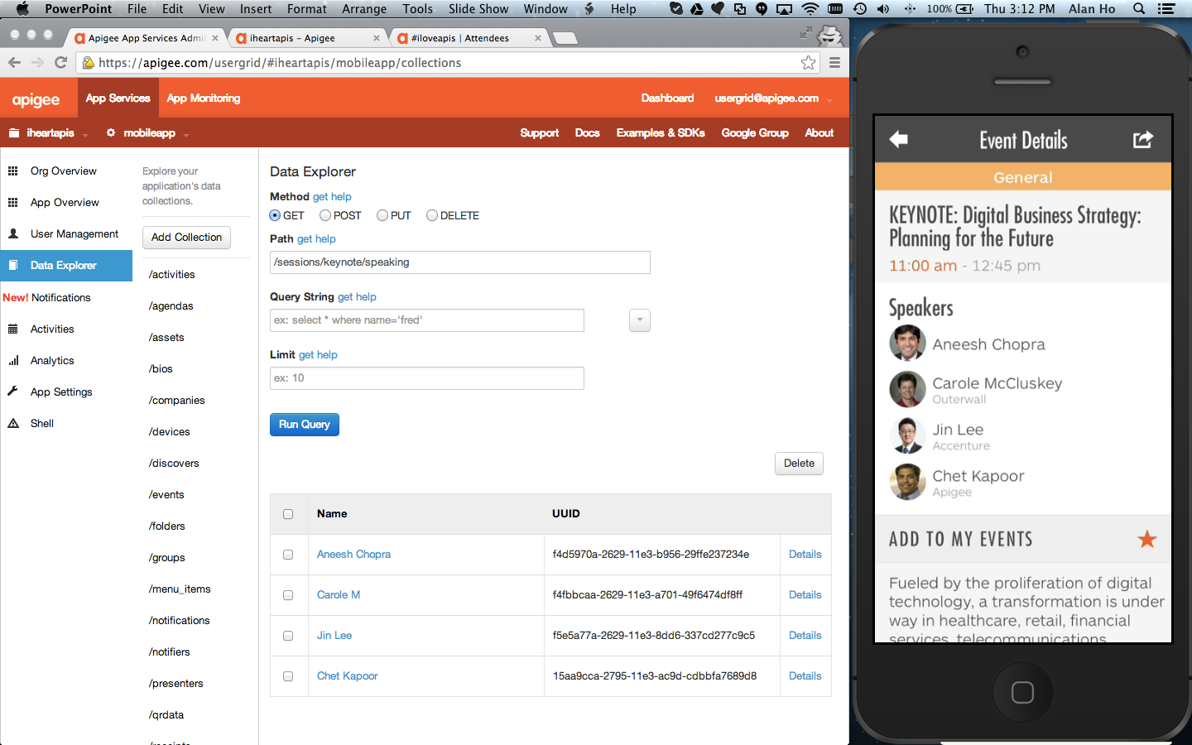
Datastore - Relationships

Slide 23
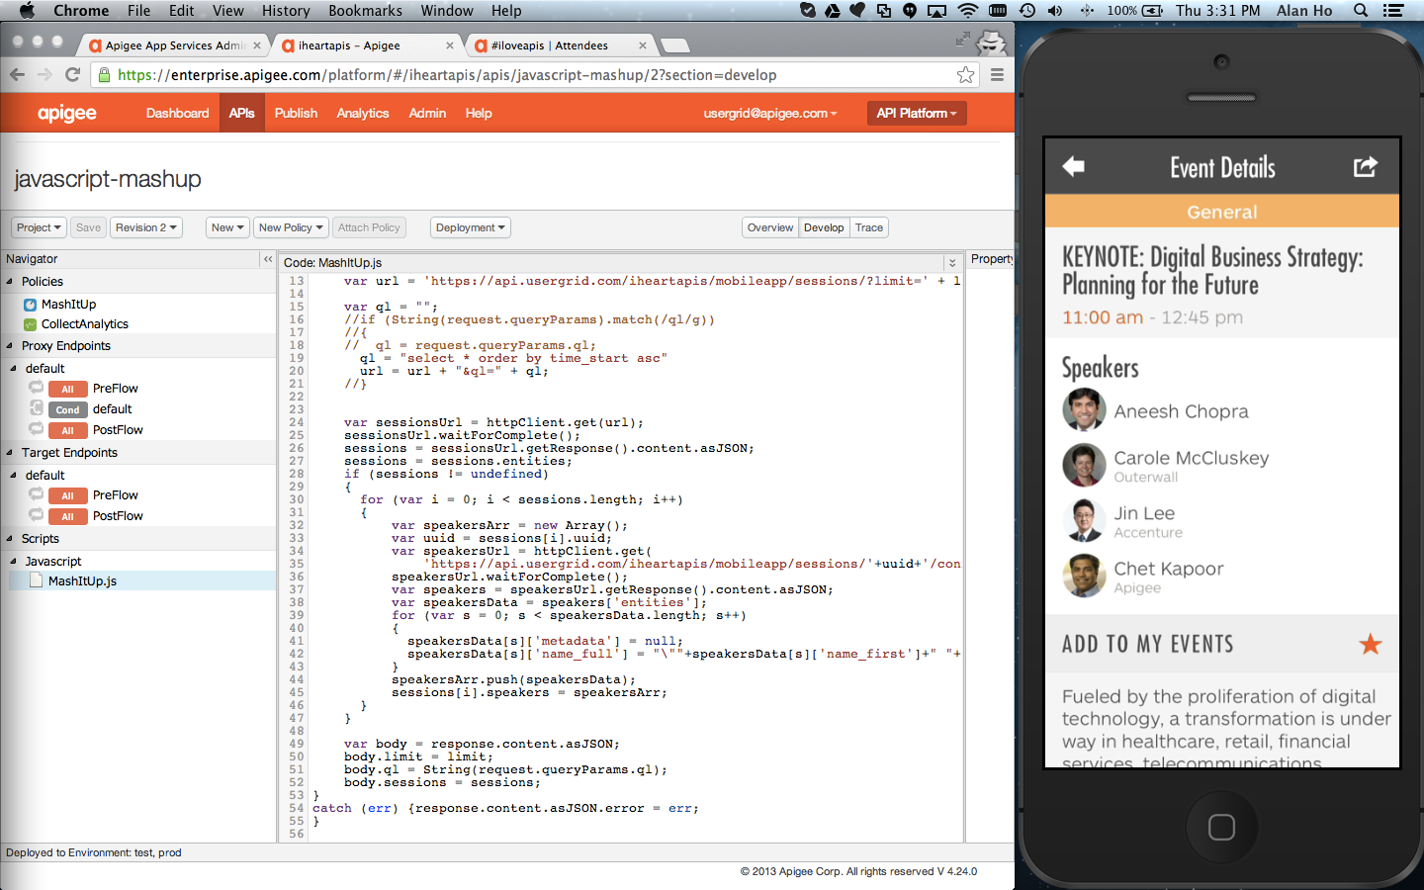
Node.js Mashup for Fast APIs

Slide 24
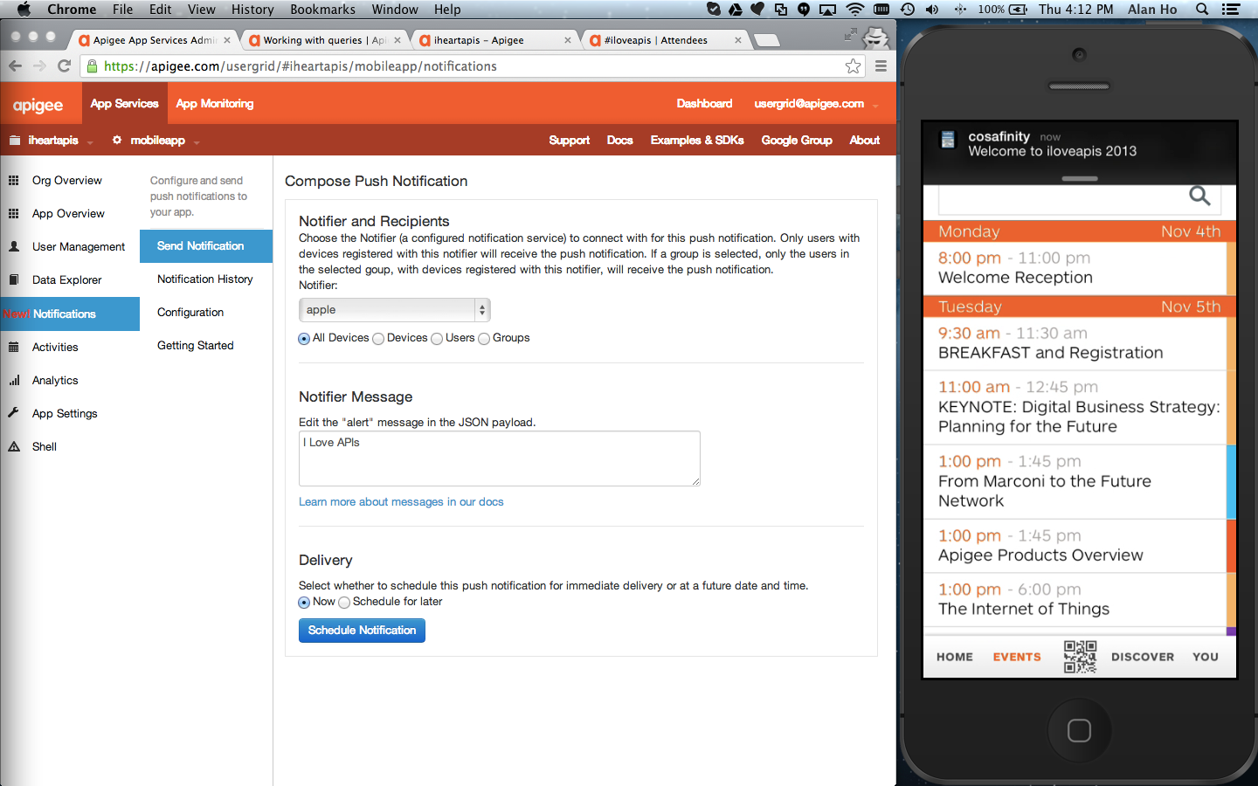
Push Notifications

